Slide 1
TD3 alg. In PID control
Huang Qianyi

Slide 2


Content
A
Introduction
Dual network
Target policy smoothing regularization
applications

Slide 3
INTRODUCTION
The TD3 algorithm is also a deterministic deep reinforcement learning algorithm under the Actor-Critic (AC) framework. It combines a deep deterministic policy gradient algorithm and dual Q-learning, and has achieved good performance on many continuous control tasks.

Slide 4



Dual network
​​​​​
The TD3 algorithm includes six networks, namely Actor network
Critic1 network
Critic2 network
Target Actor network
Target Critic1 Network
Target Critic2 Network
Compared with the DDPG algorithm, the TD3 algorithm has an additional critic network, which is the origin of the dual network.

Slide 5
WHY we use dual network
Because the network overestimates, the main reasons include bootstrapping and maximization. If the overestimation is uniform, it will not have an impact on the agent's final decision; if it is non-uniform, it will have an impact on the agent's final decision. Significant impact.
Each time the state-action is sampled to update the Critic network, the network will overestimate the value of the state-action of (s,a), while The frequency in the experience pool is obviously uneven. The higher the frequency, the greater the overestimation. Therefore, the network's overestimation is non-uniform, and non-uniform overestimation is harmful to the agent's decision-making, so we need to avoid network overestimation.

Slide 6

Dual networks are an efficient way to solve maximization problems. In the TD3 algorithm, the author introduces two sets of critic networks with the same network architecture. When calculating the target value, the smaller value between the two will be used to estimate the next state action pair (s′, a′) state action value
“
”

Slide 7
Target policy smoothing regularization
There is a problem with the deterministic strategy: it overfits to shrink the peaks in value estimates. When updating the Critic network, the learning target using a deterministic strategy is extremely susceptible to function approximation errors, resulting in large variance in target estimation and inaccurate estimation values. This induced variance can be reduced by regularization
The specific implementation is to use the area around the target action to calculate the target value, which is beneficial to smoothing the estimated value.

Slide 8
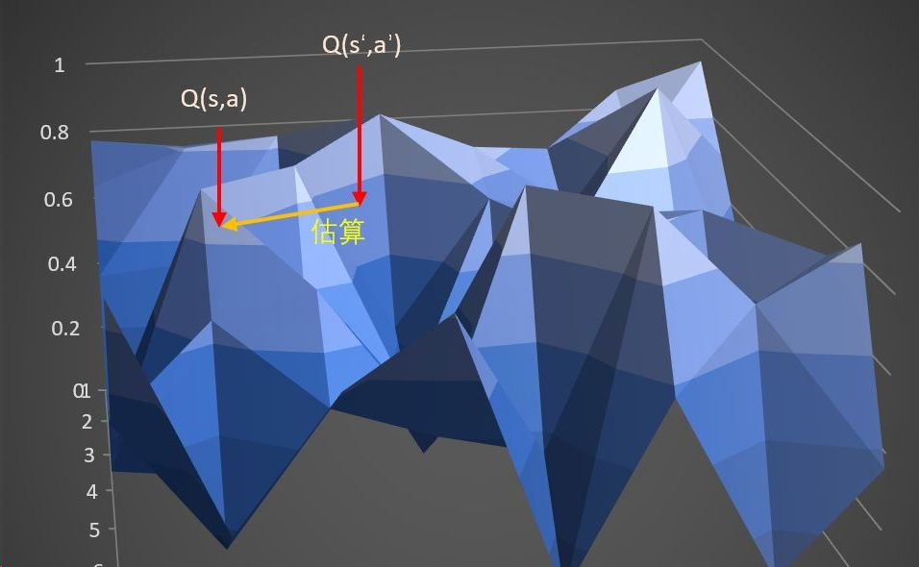

Two examples
Here we directly use Q(s′,a′) to estimate Q(s,a) , so the variance will be large. Take the state-action pair (s′,a′) neighborhood to estimate Q(s,a) , which can greatly reduce the variance, improve the accuracy of target value estimation, and ensure the stability of the network training process.

Slide 9
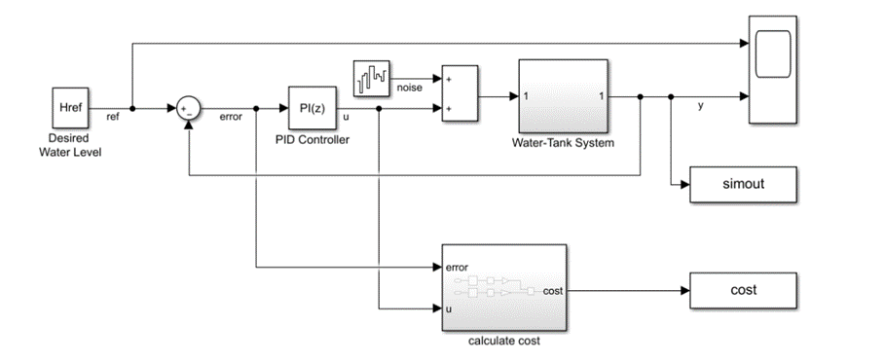
Application
This is a model of a bucket
Next, we will replace the PID control module to see the effect.

Slide 10
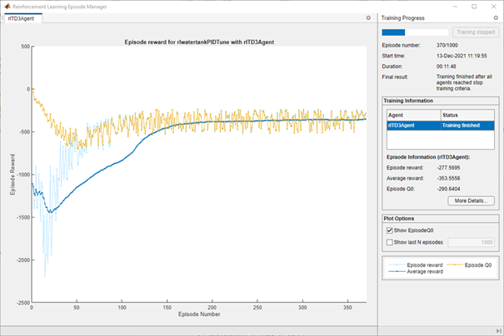
Training results
F

Slide 11
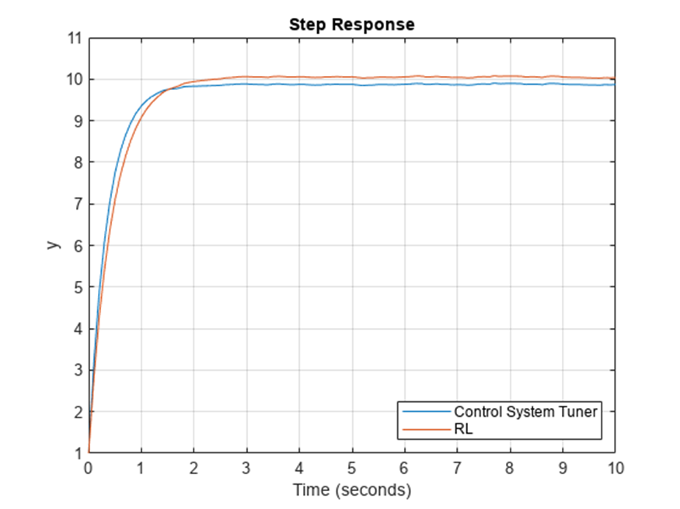
Comparations between traditional PID control and TD3
We can see that the new method is slightly better than the traditional one

Slide 12
THANKS
Huang Qianyi
t.khuan3@g.nsu.ru

